Slide 1
TACTIC-R & Parallel Computing

Slide 2
Tactic -R
Serious hospitalised COVID patients
Standard of Care, Baricitinib, Ravulizumab
Time to failure (organ failure or death)
N per arm maximum 469
Interim analyses at 2 time points, 125 & 229 per arm
Drop arms or add arms

Slide 3
Interim Analysis
Estimate hazard ratios
Consider Criteria such as
Bayesian probability (HR<0) > 0.8
Predictive probability of significance from reference sample size, for each combination of arms to continue with
Haybittle-Peto bounds p<0.001
First two we fit an MCMC model = 10000s of samples from posterior distribution
Then sample pseudo-observations from posterior predictive distribution, 1000s times to run the final analysis and estimate the chance of success
Rstanarm package makes this step easy to write

Slide 4
Simulation Study
Loop a few 100 time:
Generate Study data with fixed parameters e.g. Null, Alternative, others
Carry out interim analysis
Generate future observations and carry out final analysis (for a variety of sample sizes), including decision rules
Estimate Operating Characteristics : bias, power/type1 error, coverage, MSE
Repeat for different scenarios

Slide 5
Computational Limitation
My computer took 20 mins to do one interim analysis: 16GB Ram , 8 core processor 3.4 Ghz
University HPC via MRC BSU
Peta4 CPU Cluster, 'skylake': 1152 nodes
- 2x 16-core Intel Skylake 2.6GHz CPUs, 32 cores per node
- 768 nodes with 192GB RAM, 384 nodes with 384GB RAM (called 'skylake-himem'
- High-speed (10 GB/sec) interconnect between nodes and disk storage

Slide 6
Two Types of parallelism
Arrays
More syntax and template files to configure
like a 4*4 off-road vehicle: will get there
Only relevant inside a large cluster of nodes such as HPC
Parallel Core processing
Easy to modify your existing R script (maybe SAS and stata as well??)
Not necessarily quicker unless the inner loop is longer than a few minutes
Can run on your PC if you have a parallel core processor
Like an Alpha-Romeo: faster sometimes, but high maintenance.

Slide 7
Array Processing
write a computer programme in R, that
generates random data
Analyses it
writes an output file
Run the same programme as many times as you want, 100 say
Each array job can be run in parallel on a separate node (I think) , shared out over everyone using the system.

Slide 8
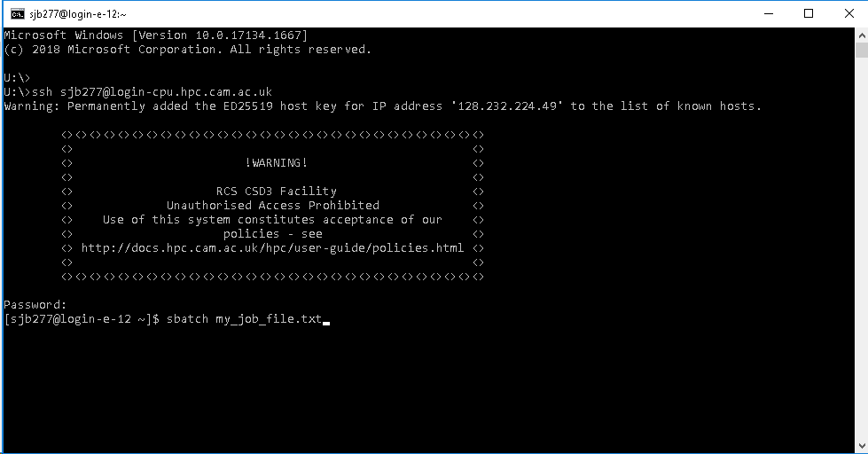
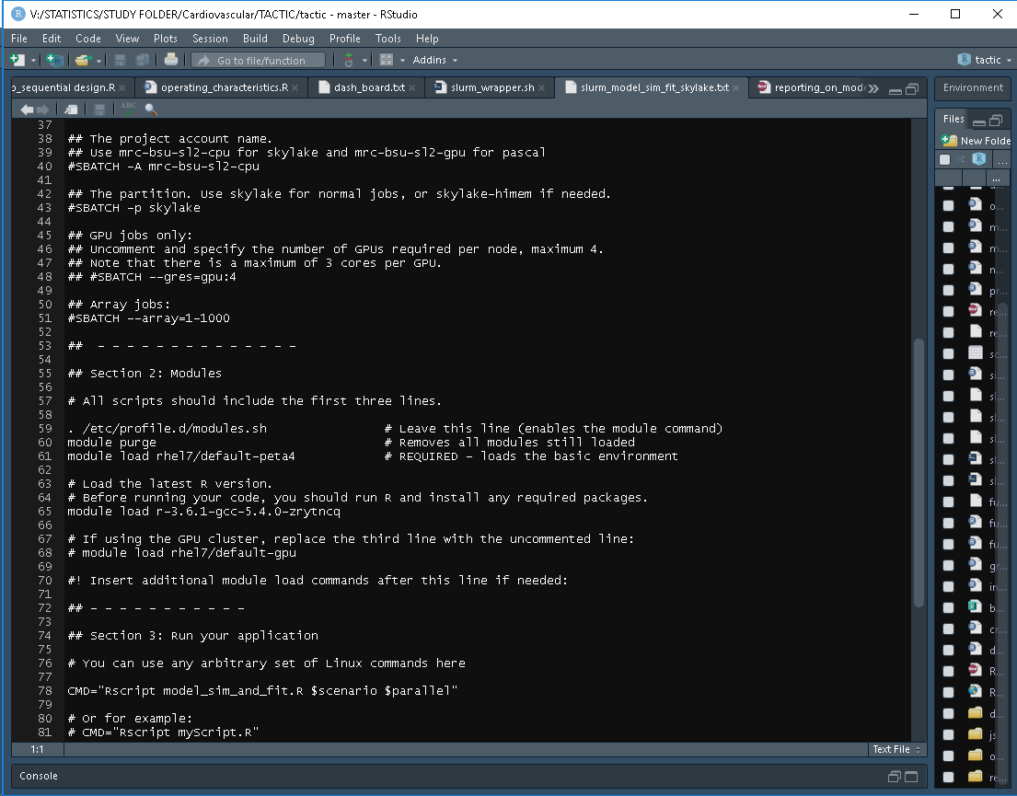
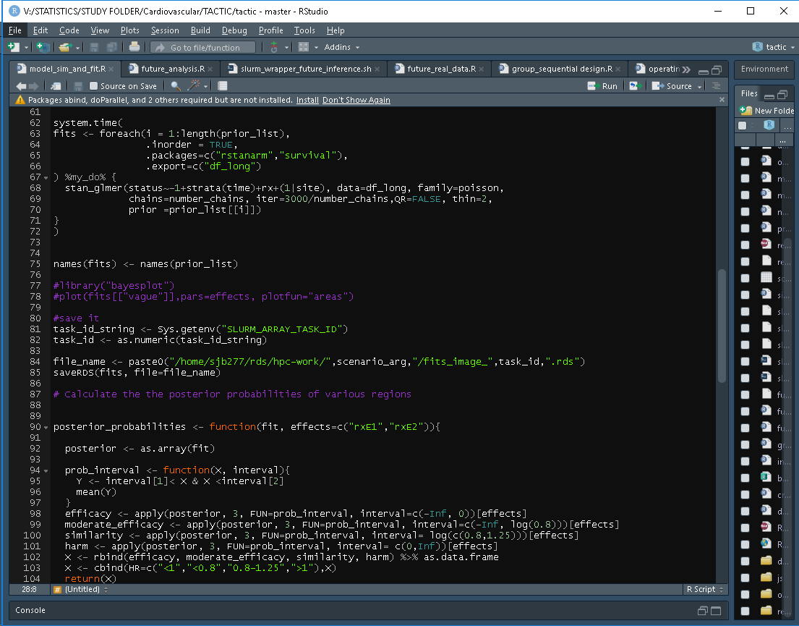

Slide 9
Core Parallel processing
Similar basic idea : repeat the same task in parallel
Arrays use lots of “nodes” = individual PC
Core processing splits up the processor into as many parts as the hardware allows
library(doParallel)
library(foreach)
cl<-makeCluster(parallel::detectCores())
registerDoParallel(cl)
clusterEvalQ(cl, .libPaths("library"))
fits <- foreach(i = 1:length(prior_list),
.inorder = TRUE,
.packages=c("rstanarm","survival"),
.export=c("df_long")
) %dopar% {
stan_glmer(status~-1+strata(time)+rx+(1|site), data=df_long, family=poisson,
chains=number_chains, iter=3000/number_chains,QR=FALSE, thin=2,
prior =prior_list[[i]])
}

Slide 10
Summary
Overview of TACTIC-R simulation work
Computing resources available
Two ways to possibly speed up your computations

